Slide 1
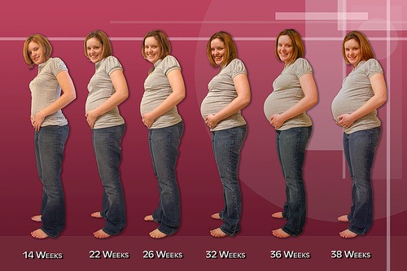
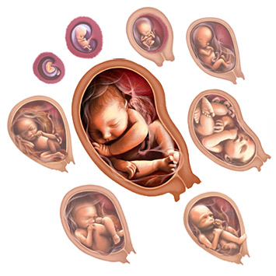
Changes in a Woman’s Body During Pregnancy
Fetal Development

Slide 2
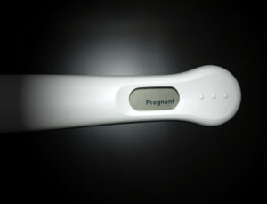
Detecting Pregnancy
Hormonal changes affect almost every organ system in the body
First sign of pregnancy =
Missed period

Slide 3
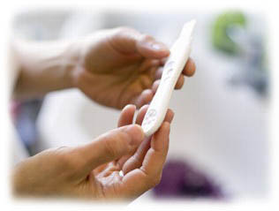
Signs of Pregnancy
Swollen, tender breasts
Fatigue
Nausea or vomiting
Abdominal bloating
Frequent urination

Slide 4
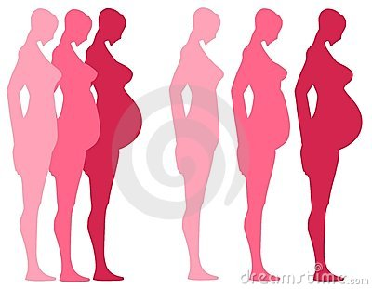
Trimesters
Pregnancy is measures in trimesters from the first day of your last menstrual period
Lasts 40 weeks from conception to birth of the baby

Slide 5
1st Trimester

Slide 6
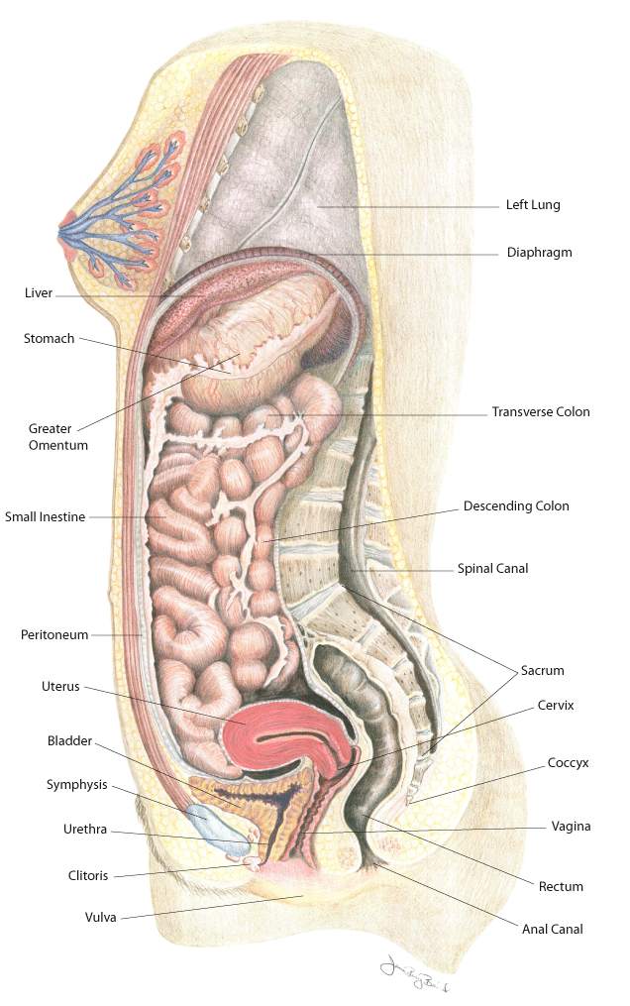
Before Pregnancy

Slide 7
Changes in the Mother
Extreme tiredness
Tender, swollen breasts
Morning sickness
Cravings or distaste for certain foods
Mood swings
Frequent urination
Weight gain= 2-4 pounds

Slide 8
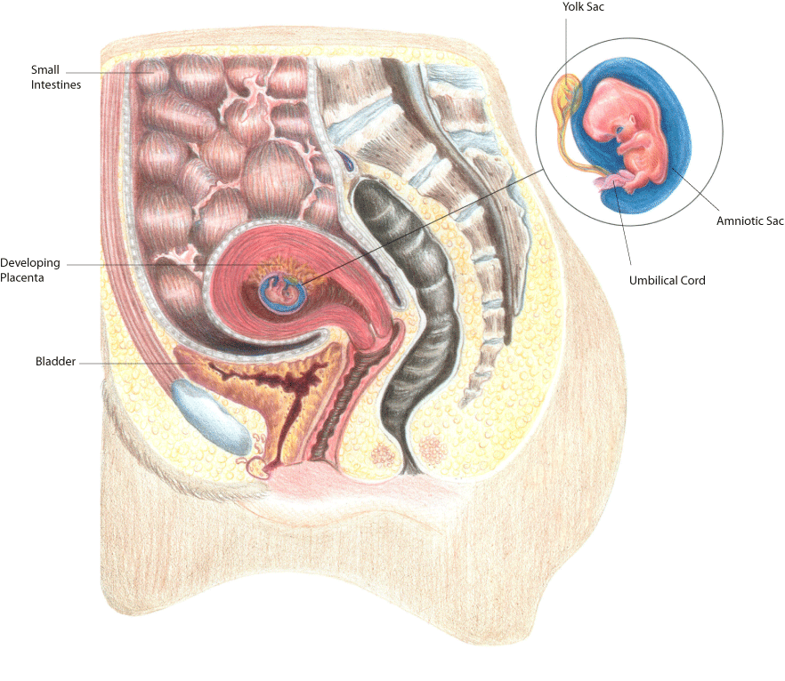
6 and 7 Weeks Pregnant

Slide 9
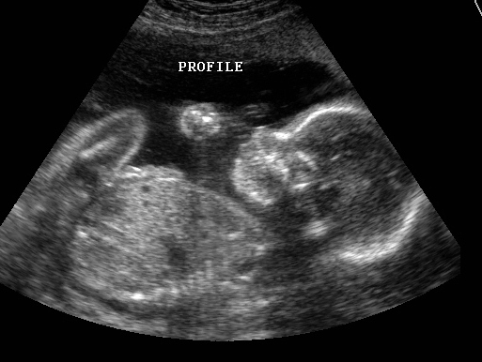
1st Ultrasound at 6-10 weeks
A prenatal ultrasound (also called a sonogram) is a noninvasive diagnostic test that uses sound waves to create a visual image of your baby, placenta, and uterus, as well as other pelvic organs
It allows your healthcare practitioner to gather valuable information about the progress of your pregnancy and your baby's health.

Slide 10
Fetal Development
Weeks 1-9
Months 1-2
1st Trimester
http://www.babycenter.com/2_inside-pregnancy-weeks-1-to-9_10302602.bc

Slide 11
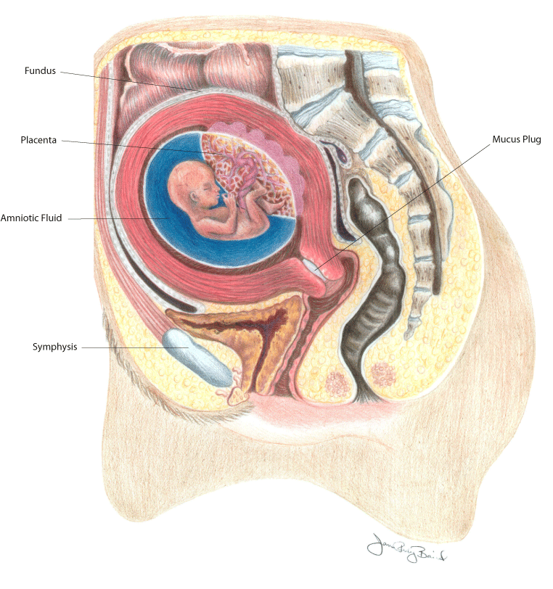
12 Weeks Pregnant
External sex organs show if the baby is boy or girl

Slide 12
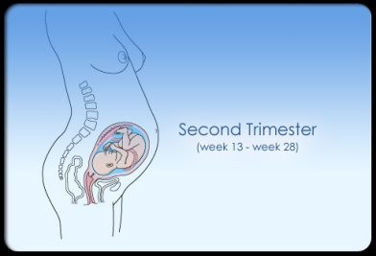
2nd Trimester

Slide 13
Changes in the Mother
Body aches
Stretch marks
A birthing line
Swelling of ankles, fingers, and face
Appetite increases
Fetal movements
Weight gain= 10-12 pounds

Slide 14
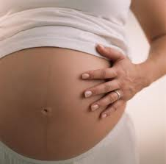
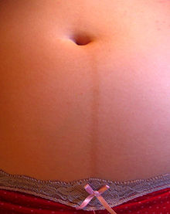
Dark vertical line that appears on the abdomen

Slide 15
Fetal Development
Weeks 10-14
Months 3-4
1st - 2nd Trimester
http://www.babycenter.com/2_inside-pregnancy-weeks-10-to-14_10308108.bc

Slide 16
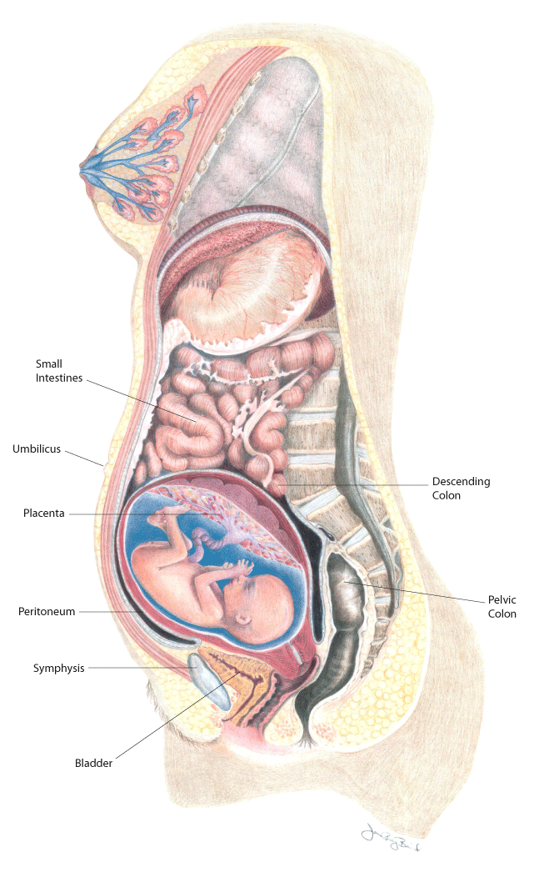
20 Weeks Pregnant

Slide 17
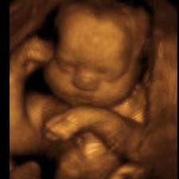
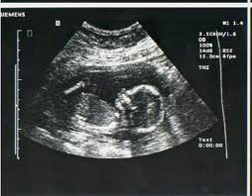
2nd Ultrasound at 20 weeks
Determine sex
Further ultrasounds in pregnancy are up to parents and doctors

Slide 18
Fetal Development
Weeks 15-20
Months 4-5
2nd Trimester
http://www.babycenter.com/2_inside-pregnancy-weeks-15-to-20_10308111.bc

Slide 19
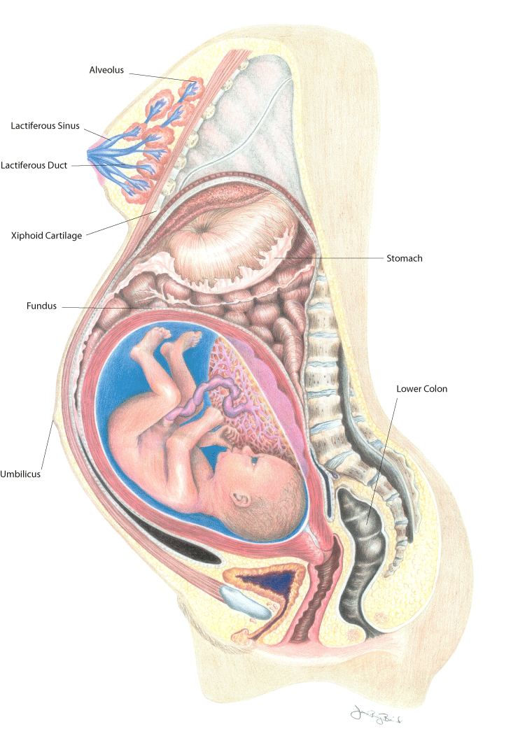
28 Weeks Pregnant

Slide 20
Fetal Development
Weeks 21-27
Months 6-7
2nd Trimester
http://www.babycenter.com/2_inside-pregnancy-weeks-21-to-27_10312242.bc
Caution- detailed shot of pregnant woman

Slide 21
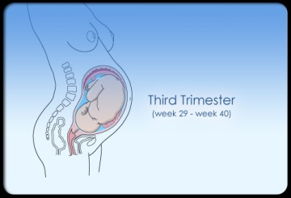
3rd Trimester

Slide 22
Changes in the Mother
Shortness of breath
Heartburn
Swelling of ankles, fingers, and face
Tender breasts
Belly button may stick out
Trouble sleeping
Baby “dropping” (lightening)
Contractions
Weight gain= 25-35 pounds

Slide 23
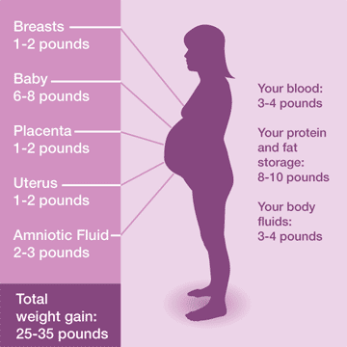

Slide 24
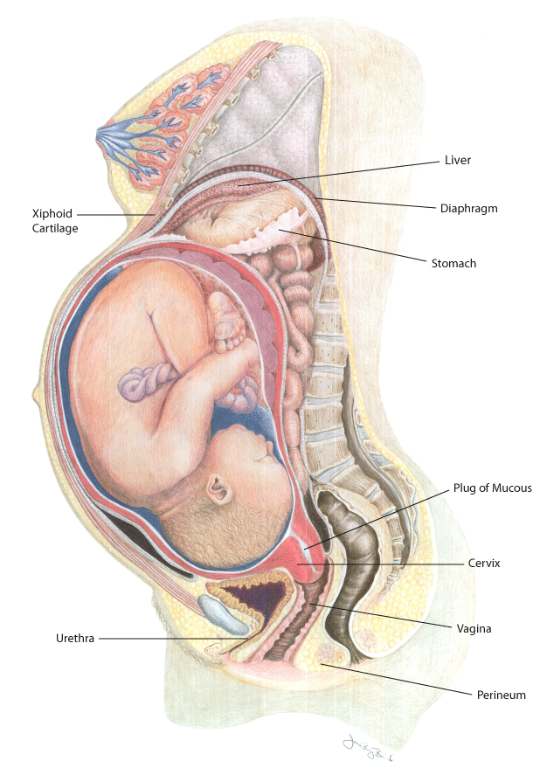
36 Weeks Pregnant

Slide 25
Fetal Development
Weeks 28-37
Months 8-9
3rd Trimester
http://www.babycenter.com/2_inside-pregnancy-weeks-28-to-37_3658874.bc
Caution- detailed shot of pregnant woman

Slide 26
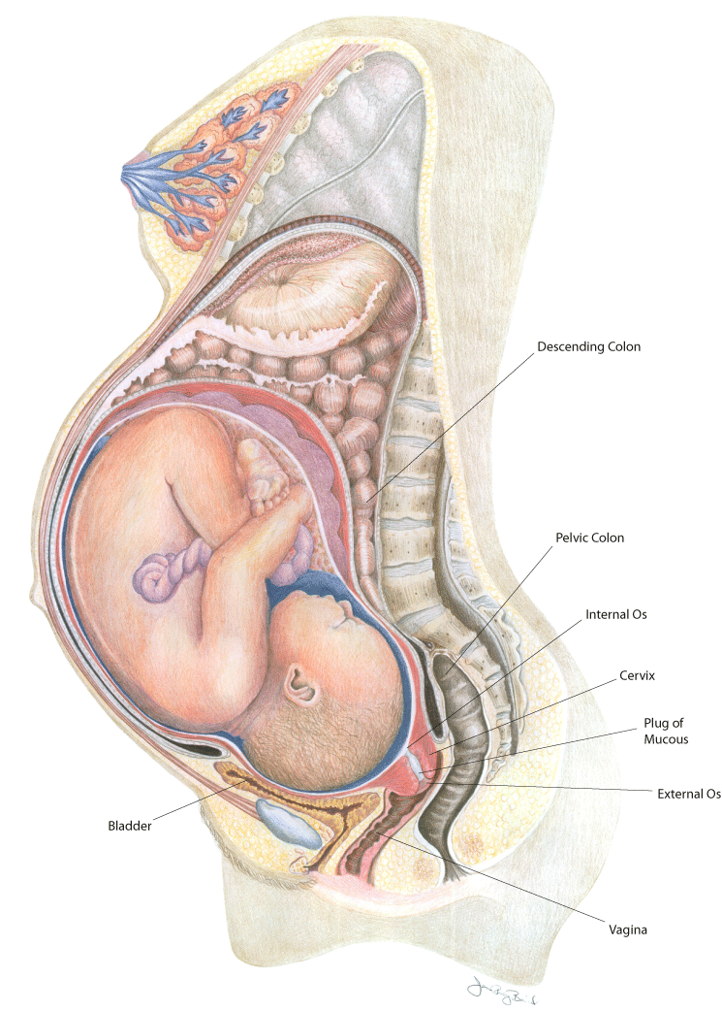
Pregnancy at Term (Internal View of 40 Weeks Pregnant)

Slide 27
Weight Loss After Pregnancy
At delivery:
Baby
Placenta
Amniotic Fluid
Blood
Typically leaves most new moms about 12 pounds lighter The weight keeps coming off, too.
All the extra water that cells retained during pregnancy, along with fluid from the extra blood stored in the pregnant body, will be looking for a way out.
Produce more urine than usual in the days after birth — an astounding 3 quarts a day
Perspire a lot, too.
By the end of the first week, new moms lose about 4 pounds of water weight
(The amount varies depending on how much water was retained during pregnancy)
Uterus:
By four to six weeks, it should be close to its pre-pregnancy size

Slide 28
Topic Extension Projects
Multiple Births
Miscarriages

